Slide 1
Energy Demand Estimation Using Time Series Forecasting
Ashish Ahuja

Slide 2
Biography
Education
Bachelor of Engineering (Electrical)
Masters of Science (Electrical & Computer Engg)
Professional experience
Electrical Systems Professional
Data science learnings and experience
Sensor Data Analytics
Relevance to the project
Energy Demand Forecasting comes from Electrical Domain

Slide 3
Project Context
Industry or domain
Energy Demand Forecasting is a critical application
Statistical techniques are mostly used
Can be applied to any industry with demand forecasting
Problem area
Develop model for forecasting electrical energy demand
Accurate forecasting key for planning in utilities
Inaccurate forecasting can lead to generation shortage, affect electricity price or even cause outage.
Improve forecasting accuracy
Many techniques proposed. Statistical techniques state-of-the-art
Why is this area interesting?
Key of electrical utility operations

Slide 4
Business Context
Business aspects
Stakeholders
Energy Markets, Electricity Generation and Distribution Companies, End Customers
Electricity price and availability affected
Improve forecast accuracy for optimize network operations
Business question
Can forecast accuracy be improved?
Reduce operational losses
Large deviations in forecasted values can increase losses and risk of grid failure
Data science aspects
Data question
Use historical demand values to forecast future demand
Energy measurements on the electrical network

Slide 5
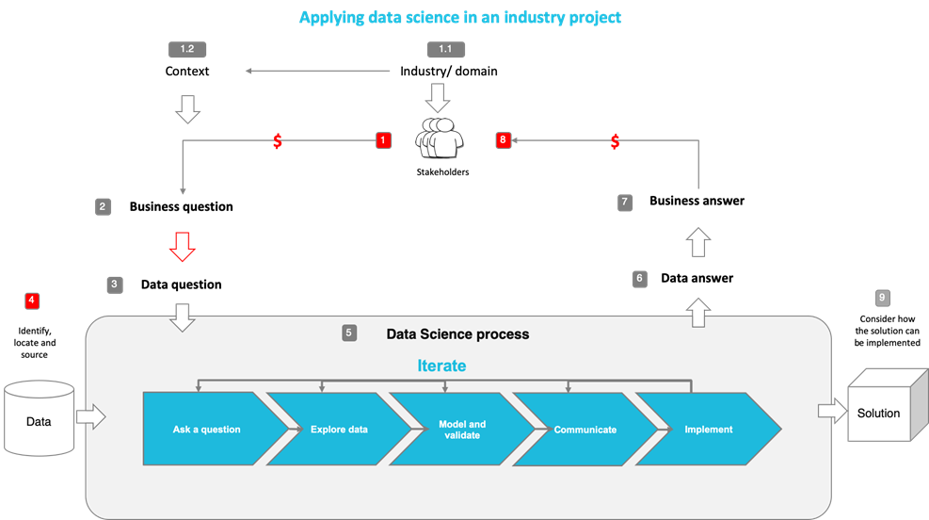
Design
Notes:
The following diagram shows the overall end-to-end process for defining, designing and delivering the Capstone project.

Slide 6
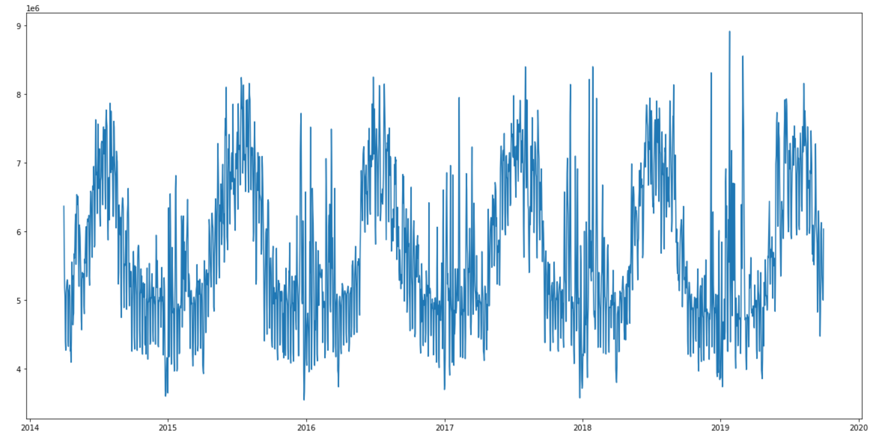
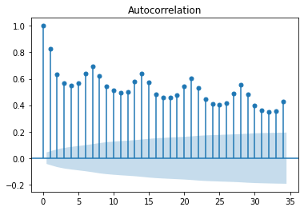
Design
Data exploration, analysis and visualisation
Dataset:
Electrical Energy Demand
Insights:
Seasonal Pattern
Peaks associated with
External factors

Slide 7
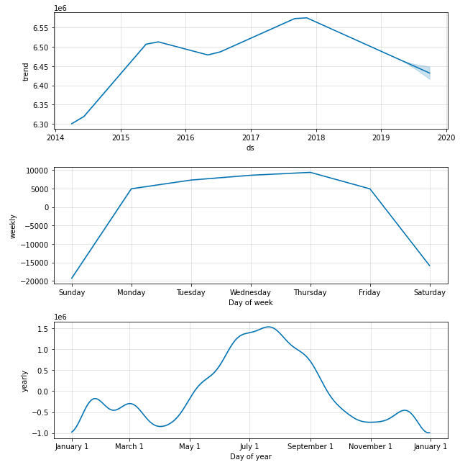
Approach
Feature engineering
Historical Values of energy demand used for forecasting
Machine models used and their
Time Series Forecasting Model using Prophet
Trend
Seasonality (period, Fourier coefficients)
External Events
Time Series Forecasting Model using NeuralProphet
Trend, Seasonality, External Events
Auto Regression using Neural Network
Evaluation metrics – Comparison with Baseline Average Model using:
Mean Absolute Percentage Error (MAPE)
Mean Absolute Error (MAE)
Root Mean Square Error (RMSE)
Mean Absolute Scaled Error (MASE)

Slide 8
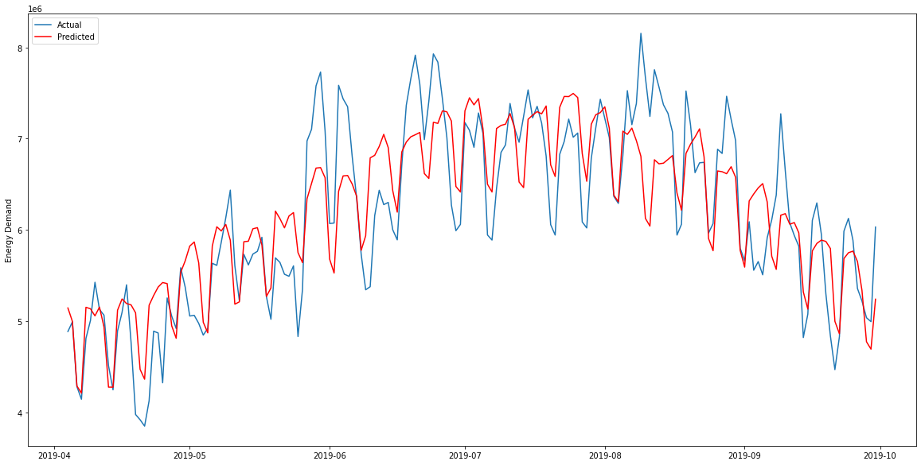
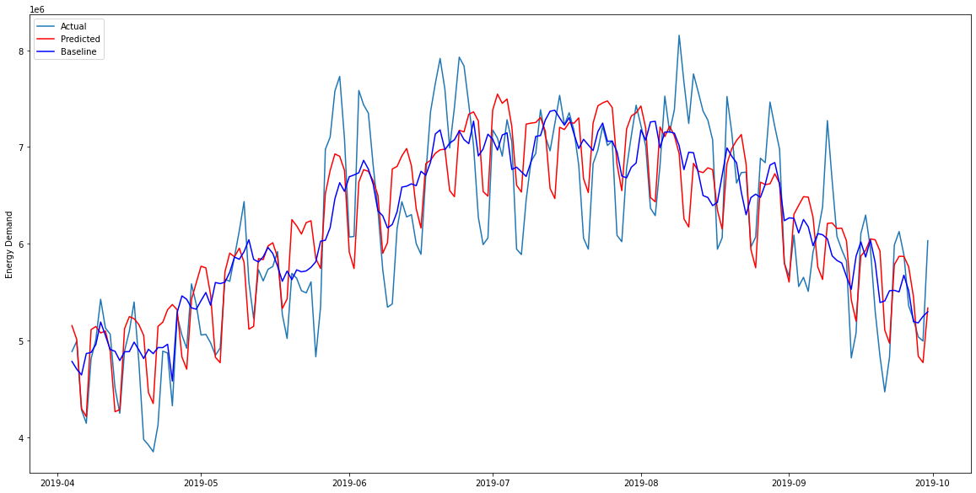
Results
Prophet – Horizon = 180 days
NeuralProphet – Horizon = 180 days
PROPHET
MASE | MAPE | MAE | RMSE
1.069 | 6.914 | 421150.14 | 528859
NEURAL PROPHET
MASE | MAPE | MAE | RMSE
1.056 | 6.86 | 415976.45 | 514259.46
BASELINE AVERAGE (MODEL)
MASE | MAPE | MAE | RMSE
1.072 | 7.09 | 422085.29 | 527047.56

Slide 9
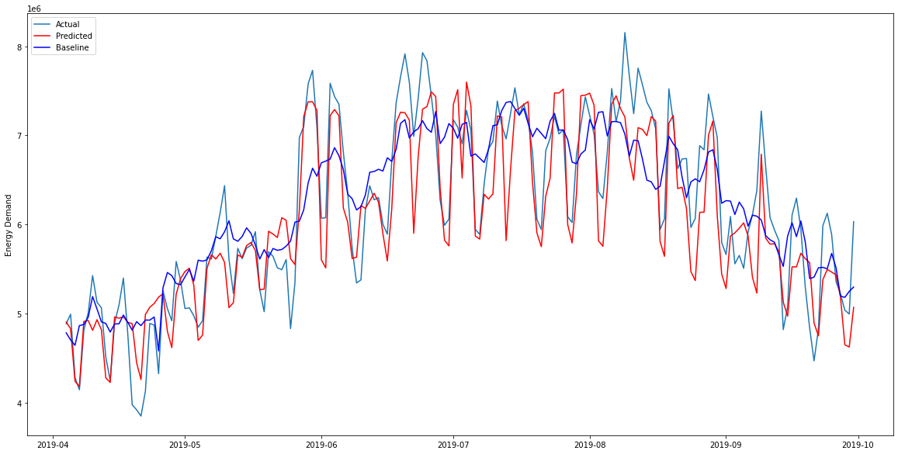
Results
NeuralProphet with External Factors– Horizon = 180 days
MASE | MAPE | MAE | RMSE
0.88 | 5.734 | 349350.37 | 435786.79

Slide 10

Summary, Conclusions and Next Steps
Summary
Energy Demand Estimation using Time Series Forecasting
Seasonal pattern were captured by methods presented.
Conclusions
NeuralProphet presents slightly better results.
Next steps
Further fine of hyper parameters possible.
External factors can help in forecasting peaks

